Slide 1
When to share and not to share information
Financial Aid Offices and requests for data
COSUAA
May 1, 2017
Rebecca Flake, Cooley Higher Education
Mary Sommers, Director of Financial Aid University of Nebraska at Kearney

Slide 2
How did we get here?
A brief review of NASFAA’s endeavors in this area.

Slide 3

NASFAA code of conduct and statement of ethical principles
2013-2014 NASFAA Board appointed a task force to re-examine in the light of new challenges and dynamics.
NASFAA BOD approves revised Code and Statement in March, 2014.
Throughout the work of the task force, data requests consistently came up as an issue of concern.

Slide 4
Code verses the statement
Statement of Ethical Principles
Code of Conduct
Code of Conduct is prescriptive: rules of conduct.
NASFAA members must comply with the Code of Conduct.
There are enforcement procedures tied to the items in the Code.
Aspirational
NASFAA members should strive to meet these goals.
No process for enforcement.

Slide 5
So what about data requests?
This lives in the Statement of Ethical Principles.
“Ensure that student and parent private information provided to the financial aid office by applicants is protected in accordance with all state and federal statutes and regulations, including FERPA and the Higher Education Act. “
Protect the information on the FAFSA from inappropriate use by ensuring that this information is only used for the application, award and administration of aid awarded until Title IV . . .”

Slide 6

Why isn’t this in the code of conduct?
Because it is hard.

Slide 7
Primary Resources for Answers
NASFAA’s publication, July 2016 “Financial Aid Data Sharing”.
DOE’s publication, January 2017, “Guidance on the Use of Financial Aid Information for Program Evaluation and Research.”

Slide 8
Applicable Laws
Higher Education Act – 483(a)(3)(E) – use of the FAFSA data and 485B(d)(2) prohibition on use of NSLDS.
FERPA – protection of students educational record.
Privacy Act – governs the collection, maintenance and use of records by federal agencies.

Slide 9

Personally identifiable information
Per FERPA – information that alone or in combination is linked or linkable to a specific student that would allow a reasonable person in the school community to identify the student with reasonable certainty.
If PII is removed from the data, it is de-identified. De-identified data may be disclosed without the individual’s consent.

Slide 10
Educational Record
Any record that directly relates to the student and is maintained by or on behalf of, an educational agency or institution or a party acting for a the educational agency or institution.
This includes information from the FAFSA and the ISIR as well as information we receive from NSLDS and COD and any other information from a schools own financial aid systems and databases.

Slide 11
HEA 483 & 485
483(a)(3)(E)
485B(d)(2) & 485B(d)(5)(B)
Limits the use of FAFSA application data to the awarding and administration of Title IV funds and other aid programs.
FAFSA data is personally identifiable (PII).
Prohibits nongovernmental researchers or policy analysts from accessing PII from NSLDS.
Prohibits the use of NSLDS data for marketing purposes.
These prohibitions are applicable to all NSLDS data, including NSLDS data received by institutions via the ISIR.

Slide 12
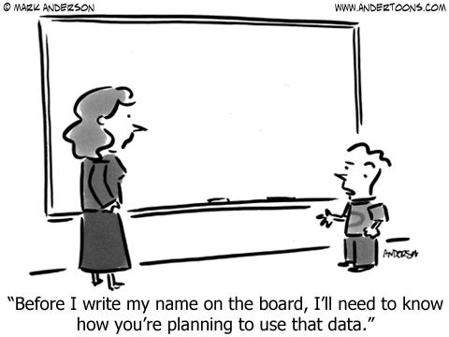
FERPA
Federal law that protects the privacy of students education records.
Applies to all educational agencies and institutions receiving funds under a program administered by the Department.
Provides the student with the right to exercise some control over the disclosure of his/her educational record, even to parents.
Affords the student certain rights relating to the access of educational records.

Slide 13
FERPA Exceptions
Financial Aid Exception – education records may be disclosed without written consent to determine aid eligibility. Ex: SAP
School Official Exception – educational records may be disclosed to others within the institution who need to know (legitimate education interest) and who are under the direct control of the institution.
Audit & Evaluation Exception – educational records may be disclosed without written consent to state and local educational authorities.
Studies Exception – educational records may be disclosed to a third party conducting a study for or on behalf of the institution for the purposes of developing, validating or administering predictive tests; administering student aid or improving instructions. There must be written agreement between the institution and the third party that includes specific provisions.

Slide 14
Privacy Act
Governs the collection, maintenance, use and disclosure by federal agencies of records contained in the agencies systems of records.
Student Aid Internet Gateway – vehicle that allows the exchange of data electronically with the DOE.
SAIG agreement dictates the conditions under which the DOE will provide to schools certain data received or generated by FAFSA applicants and/or other data providers.
Authorized personnel

Slide 15
Case Studies

Slide 16
How to Navigate common data requests.
FERPA
HEA
Privacy Act
The first question you have to ask yourself is what law applies? It may be more than one.

Slide 17
Internal data requests
The director of your institution's IR office requests a list of students including adjusted gross income, number in the family and number in college and Pell Grant eligibility from you.
The intention of the request is to match this data with persistence information as your campus President wants to know if socio-economic factors influence persistence.

Slide 18
You receive isirs from students who have not applied for admission to your institution. Can you share the students contact information with your admissions office?
What law/s apply?
What would you do and why?

Slide 19
A private outside scholarship provider requests PII (name and address) as well as adjusted gross income and efc from the FAFSA for recipients of its scholarship at your institution.
What law/s apply?
1
What do you do?
2
Do you need more information?
3

Slide 20
Institutions have the responsibility to safeguard the sensitive personal information entrusted to them, and compliance with the law is only the beginning of that process.
Minimize Disclosure: http://ptac.ed.gov/toolkit

