Slide 1
Student Debt: Rhetoric and Realities of Higher Education Financing
Sandy Baum
COSUAA
May 2017

Slide 2
Student debt: Good, bad, and misunderstood
Why is the common understanding of student debt so at odds with the realities—both the positive and the problematic aspects of borrowing for education?
How can public policy discussions better address the real problems—rather than focusing on general solutions that tend to be poorly targeted?

Slide 3
What we hear
Media anecdotes: unrepresentative, misleading
Few stories of success and opportunity
Many stories of distress
2014 public radio examples:
--Student graduated from public four-year college after transferring from community college—with $40,000 in debt. (12% of public four-year graduates had this much debt.)
--Master’s degree in history, $110,000 in debt. In income-driven repayment (now 25% of borrowers, 43% of dollars)
--Highly selective private college, $30,000 in debt, organic farmer

Slide 4
Not just good or bad
Housing market collapse, sub-prime mortgages. Should we just make housing free / have people stop borrowing for housing?
Marriage analogy: when, why, to whom?
Public benefits not the same as a public good
Positive impact: educational opportunity, responsibility for private benefits

Slide 5
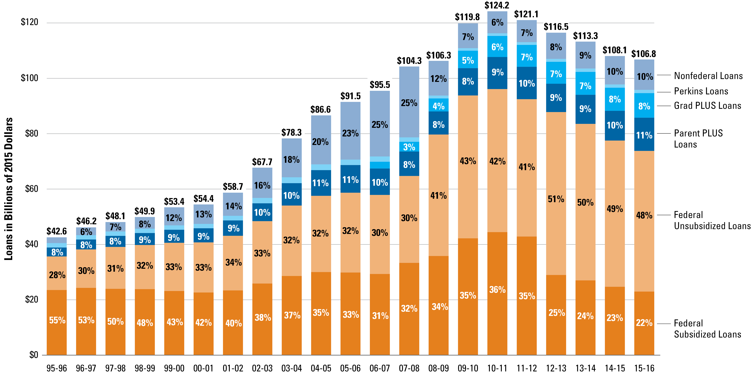
Total federal and nonfederal loans in 2015 dollars, 1995-96 to 2015-16
SOURCE: The College Board, Trends in Student Aid 2016, Figure 5

Slide 6
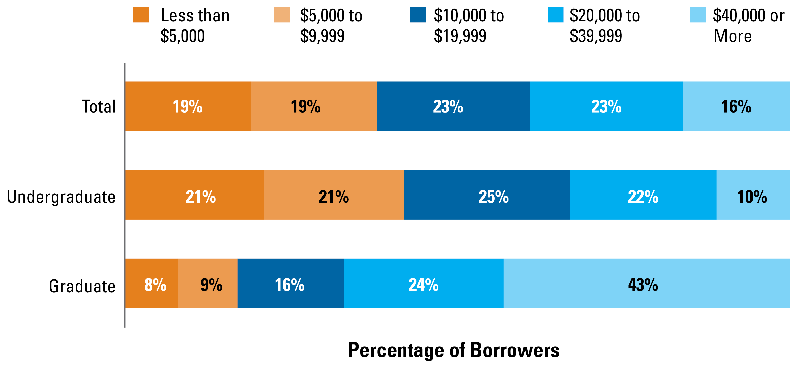
Distribution of borrowers by amount of outstanding education debt, 2015
SOURCE: The College Board, Trends in Student Aid 2016, Figure 8

Slide 7
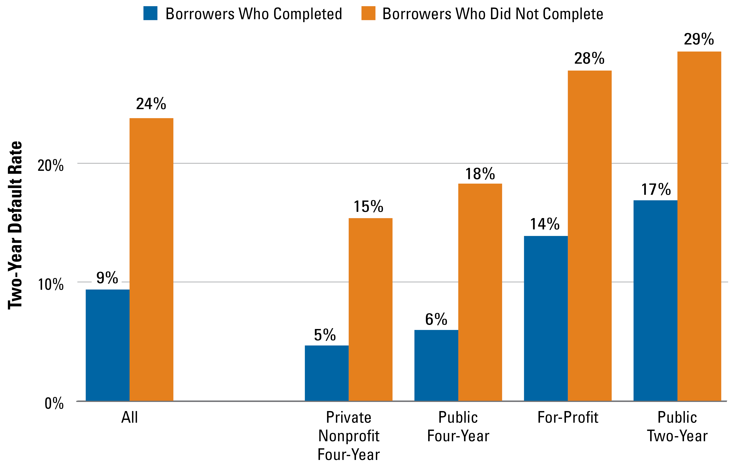
Two-year federal student loan default rate, borrowers entering repayment in 2011-12, by sector and completion status
SOURCE: The College Board, Trends in Student Aid 2016, Figure 12A

Slide 8
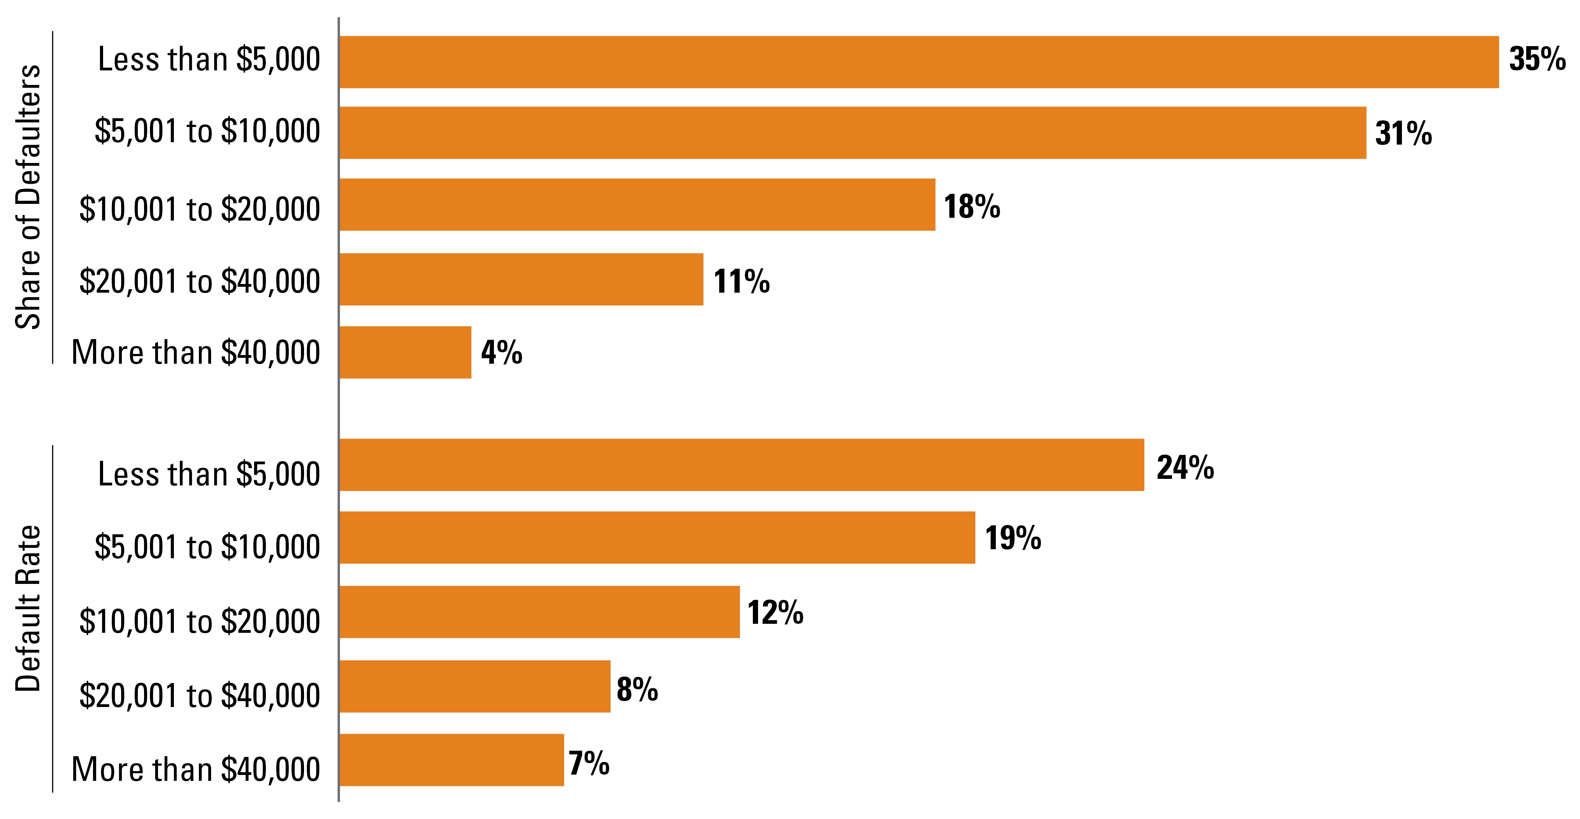
Share of defaulters and three-year federal student loan default rate, borrowers entering repayment in 2010-11, by loan balance
SOURCE: The College Board, Trends in Student Aid 2016, Figure 12B

Slide 9
Distribution of outstanding education debt by household income quartile, 2013
Note: Income quartiles are based on 2012 household income. The upper limits for the first three quartiles are $25,000, $48,000, and $90,000.
Source: Baum et al., Trends in Student Aid 2015,The College Board, Figure 19A. Based on data from the Survey of Consumer Finances.

Slide 10
Why the misperceptions?
Strong emotional reactions to exaggerated images
Barry Glassner, The Culture of Fear – road rage
Ebola cited by 17% as nation’s most pressing problem in Gallup Poll. Four reported cases in the country.
2014 Huffington Post: Author called for “civil disobedience on a massive scale” to free millions of former students “trapped in a debtors’ prison without walls.”.
Availability cascade: Simple idea for explaining complicated concept catches on, is repeated, spreads. People claiming danger is overstated are accused of a cover-up.

Slide 11
Causation and correlation
Counterfactual for studying impact of student debt
--Same education?
--Who would pay?
Housing, wealth, entrepreneurship
Surveys measuring perceptions

Slide 12
Moral panic
Fear spreads and leads to policies disproportionate to threat
Forgive all debt
Debt free college
Free college

Slide 13
Policies: Preventing problems
Excluding institutions that don’t serve students well
Helping students make better choices—more than just information
Stronger incentives for institutional performance
More nuanced loan limits
Limits on PLUS loans
Better tracking of students across institutions

Slide 14
Policies: Managing existing debt
Don’t forgive all student debt!
Income-driven repayment /ease of repayment
Lowering interest rates?
Accumulating unpaid interest
Garnishing Social Security payments
Private loans
Bankruptcy
Lines of credit
Limits on borrowing
Taxing forgiven balances
Loan servicing

Slide 15
Conclusion
Should subsidizing students borrowers be at the top of the social agenda?
Put student debt into larger social context: early childhood, health care, neighborhoods, elementary/secondary school…..
Target reforms to causes of problems
General relief vs. subgroups
Not high debt, but non-completion
Composition of borrowers

